Slide 1

By Sazeb Anwar
Business Analyst Career Program - Capstone Project

Slide 2

Agenda
Data Exploration
Statistical Analysis using Excel
Graphical Analysis using Excel
Insert the given data into the SQL server
Import the Data from the SQL Database into PowerBI
Interactive Dashboard by using visualization tools
Conclusion and Inferences
Endnotes

Slide 3
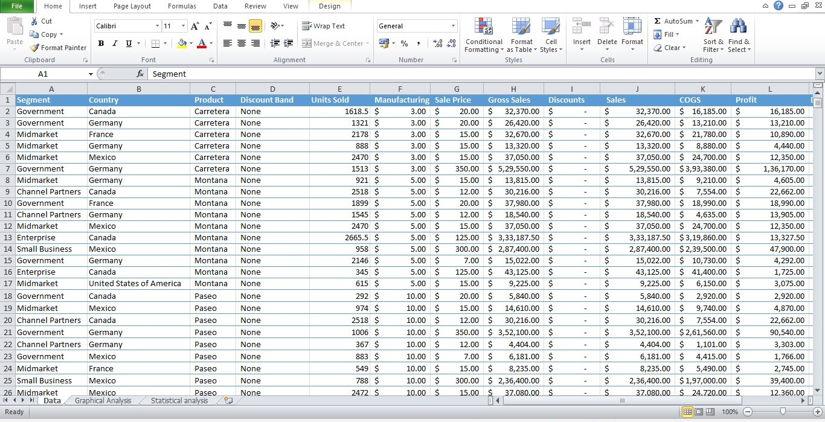
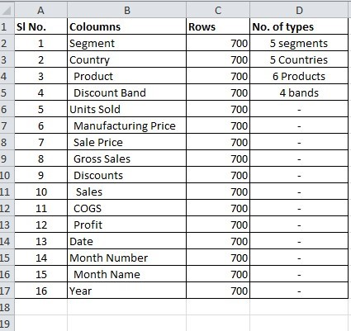
Data Exploration
Insert the relevant screenshots and give brief summary about the Data
Notes:
Data exploration using MS-Excel

Slide 4
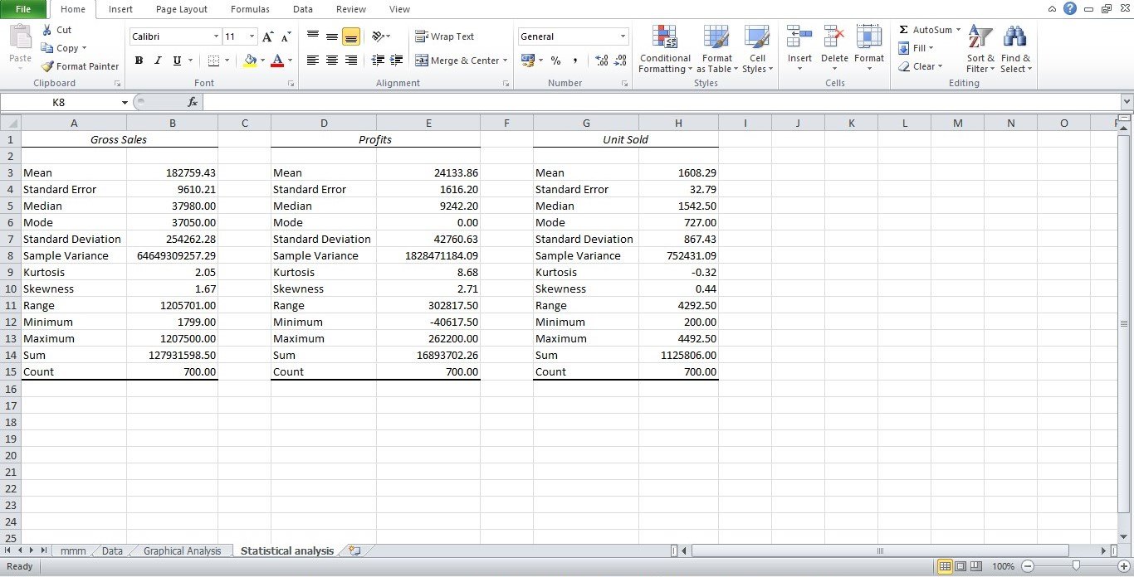
Statistical Analysis using Excel
Insert the relevant screenshots and give brief summary about the Statistical Analysis using Excel
Notes:
Performed Statistical analysis using MS-Excel of Gross sales, Profits & No. of Unit Sold

Slide 5
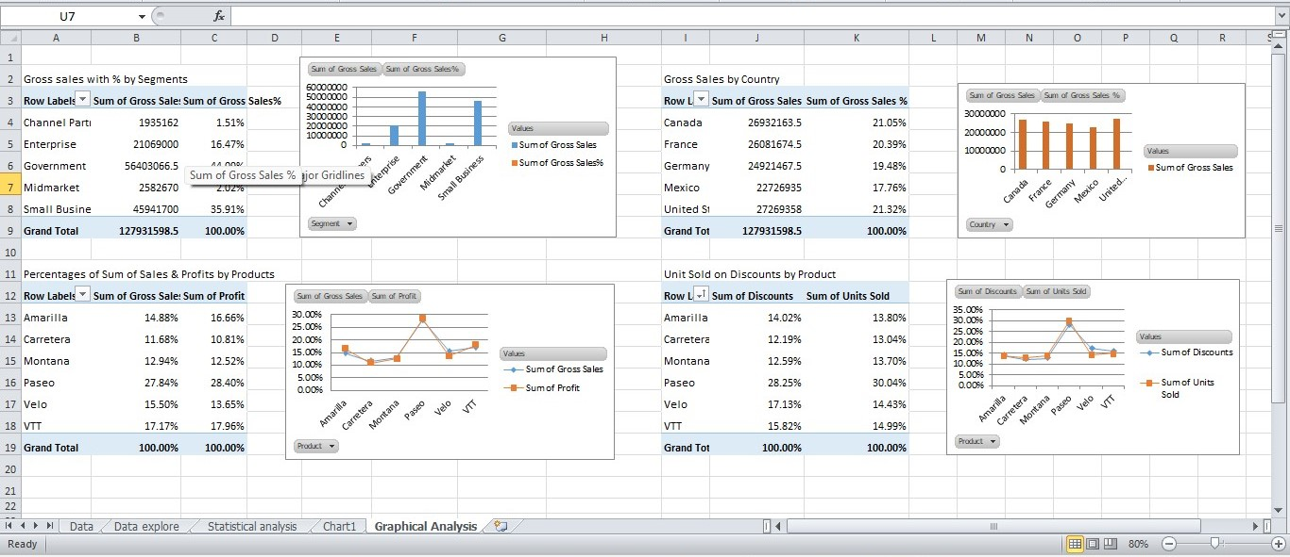
Graphical Analysis using Excel
Insert the relevant screenshots and give brief summary about the Graphical Analysis using Excel
Notes:
Graphical analysis using MS-Excel by Pivot table & charts

Slide 6
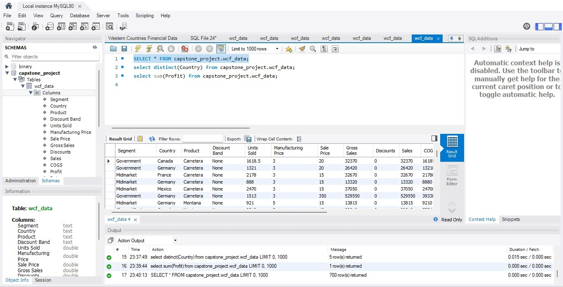
Insert the given data into the SQL server
Insert the relevant screenshots verifying that the data is successfully inserted into a SQL DB. Run a basic Queries on Data.
Notes:
Successfully imported the data in MySQL and run few Queries.

Slide 7
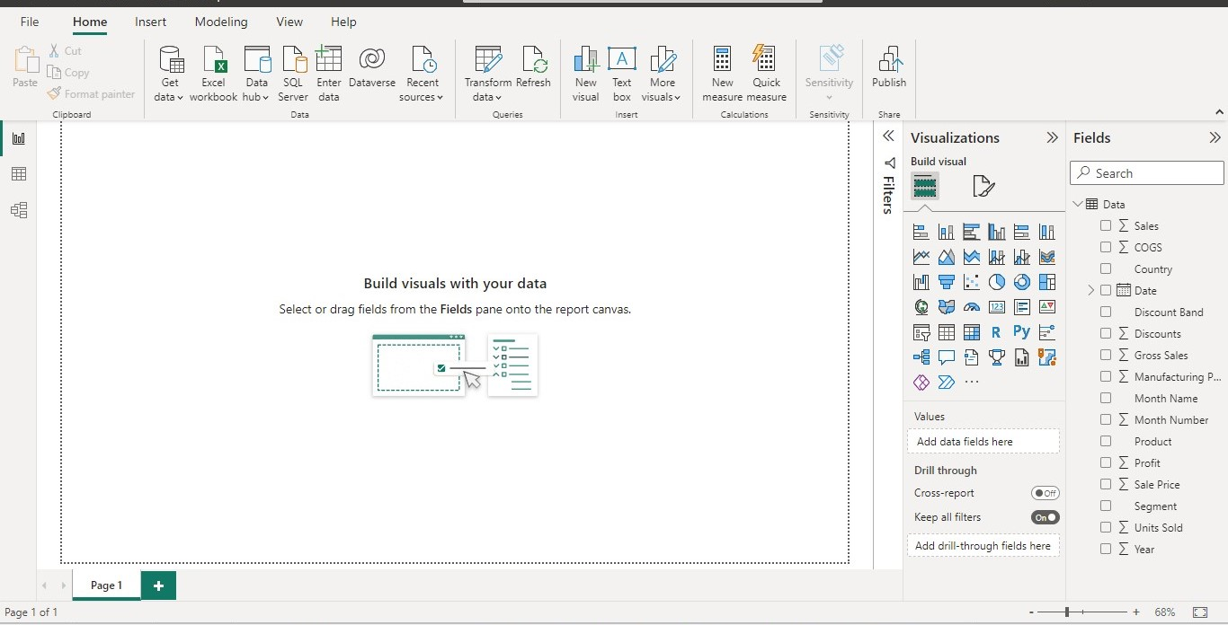
Import the Data from the SQL Database into PowerBI
(This is a dummy “about us” section)
Insert the relevant screenshots verifying that the data is successfully inserted into PowerBI and do the required data cleaning or creation of measured for data analysis
Notes:
Data properly imported in PowerBI

Slide 8
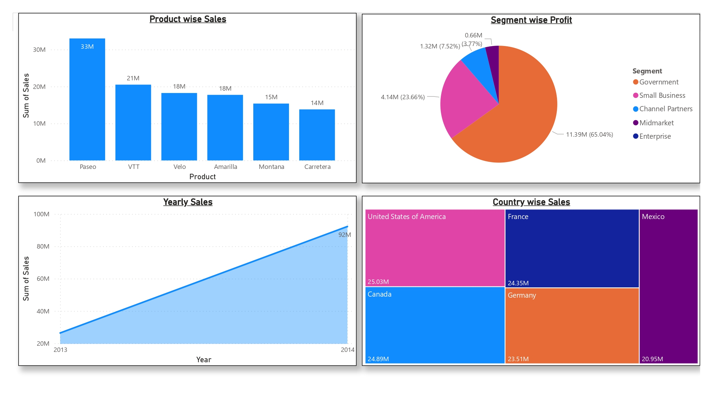
Interactive Dashboard-I by using PowerBI
(This is a dummy “about us” section)
Insert the relevant screenshots of the Dashboard made using Visualization tools such as PowerBi , Make a beautiful Dashboard that shows visually appealing graphs and data analysis.
Notes:
Created Dashboard-I using PowerBI

Slide 9
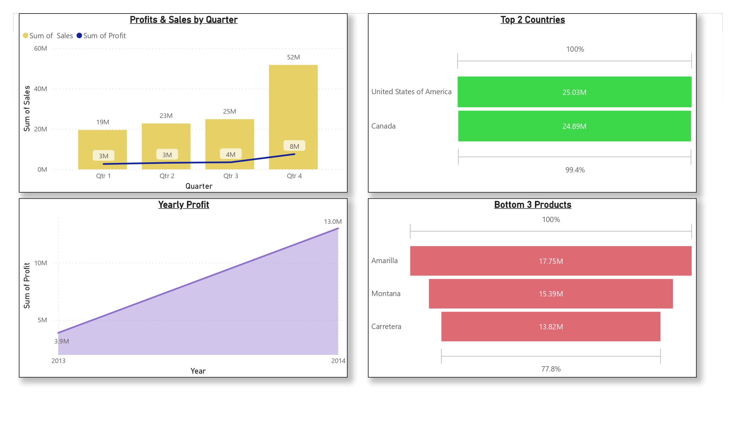
Interactive Dashboard-II by using PowerBI
(This is a dummy “about us” section)
Insert the relevant screenshots of the Dashboard made using Visualization tools such as PowerBi , Make a beautiful Dashboard that shows visually appealing graphs and data analysis.
Notes:
Created Dashboard-II using PowerBI

Slide 10
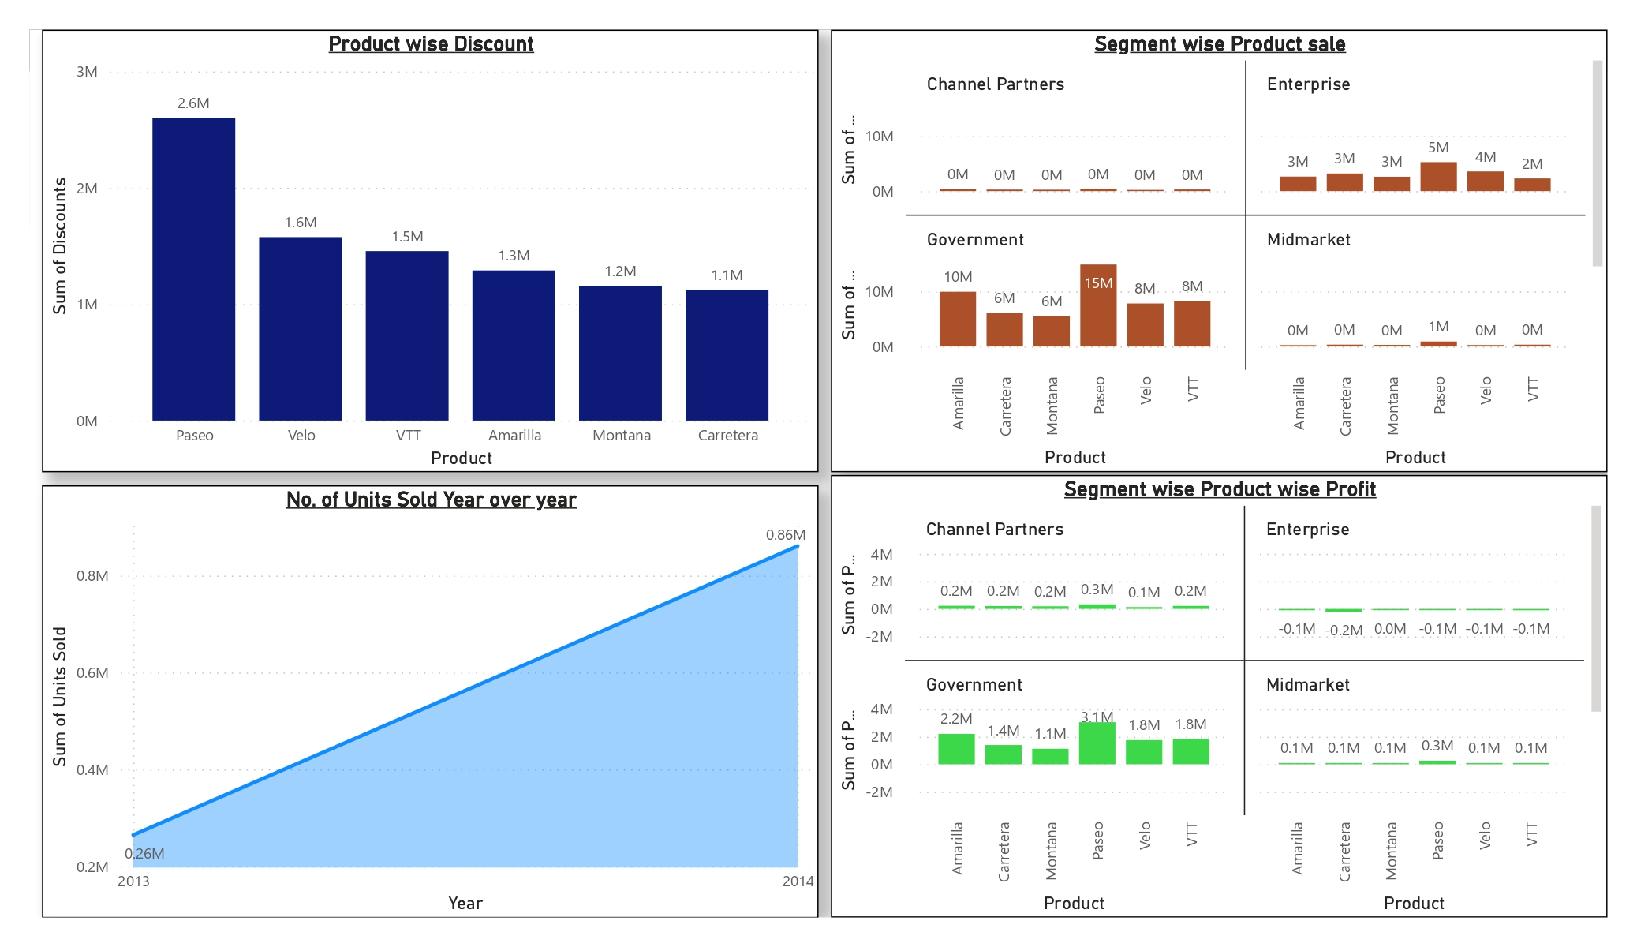
Interactive Dashboard-III by using PowerBI
(This is a dummy “about us” section)
Insert the relevant screenshots of the Dashboard made using Visualization tools such as PowerBi , Make a beautiful Dashboard that shows visually appealing graphs and data analysis.
Notes:
Created Dashboard-III using PowerBI

Slide 11
Conclusion and Inferences
Government contributes higher number of sales with high profits.
Paseo is the most sold product.
Profit Margin is almost same in all the Products.
Sales are higher on high discounts & lower on low discounts.
Sales are higher in Quarter-4
United States of America Contributes highest Sales.
Notes:
Derive Conclusion and Inferences from the Dashboards & Other analysis.

Slide 12
Endnotes
Reference Links:-
Excel file - https://docs.google.com/spreadsheets/d/1kZcZk_1JiPK73RGeWstCF-yhmJVoYC1C/edit?usp=share_link&ouid=102105860577429732670&rtpof=true&sd=true
PowerBI file - https://drive.google.com/file/d/1DWvcIHg_5ZhNNdR9KBYaj2MnKZ7hmzwa/view?usp=share_link

